Slide 1
Is it a strategic project?
Business Intelligence & Analytics

Slide 2
Recap
Chapter 1 we talked through the radio station example and decided to do the project based on a simple business case.
This chapter will discuss how we take a wider perspective. Instead of looking at each initiative individually, we want to consider the business as a whole.

Slide 3
Is the project strategic?
Yes
No
Do it!
Asses whether we should do the project

Slide 4
Is the project strategic?
Yes
No
Relates to the long-term or overall aims of the company.
Will typically be research projects (remember lead data) that modify the business as a whole.
Operational projects related to updating or creating processes.

Slide 5
Is the project strategic?
Yes
No
Do it!
?
Asses whether we should do the project

Slide 6
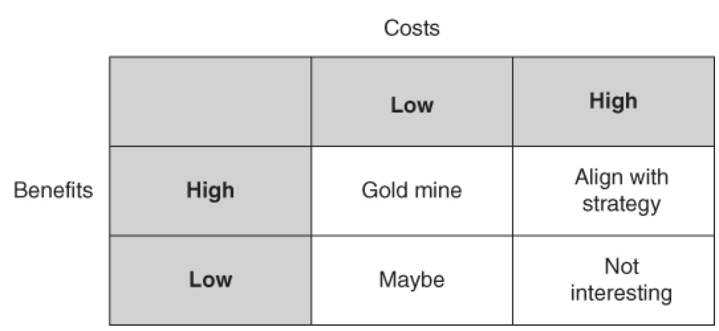
Business case
Notes
Will clearly do any project with low cost and high benefit. Note that low cost may imply the project will be done quickly.
High cost and low benefit projects will likely be rejected quickly.
Low cost, low benefit may be done depending on other priorities

Slide 7
High Cost, High Benefit
Notes
Implies that the project will take considerable resources either from the analytics staff or from the department responsible for maintaining the solution
Need to make sure it doesn’t adversely affect the company’s agility
Agility meaning the ability to respond quickly to changes in the market
May need to add opportunity costs to the calculation
Sometimes projects of this nature get delayed for other projects

Slide 8
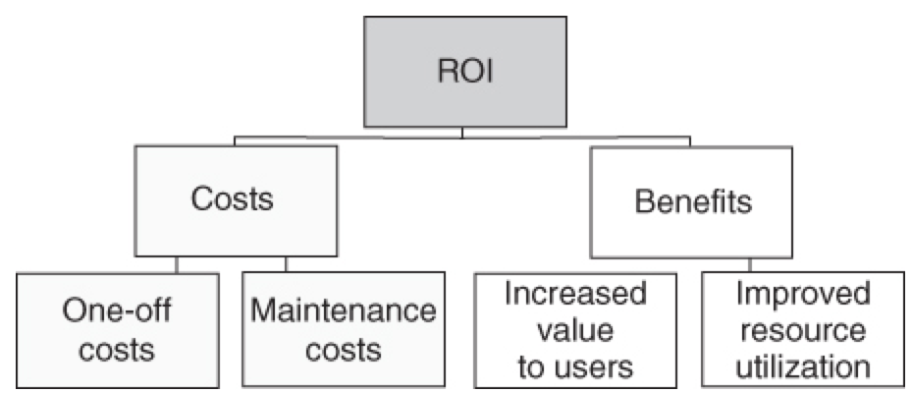
Further breakdown ROI
Notes
Rarely only incur one-off costs
Generally will be some increase to the cost of current operations or other costs (additional software purchases)
Benefits can be for the business (internal users) or for customers (external users)
Benefits could come in the form of better using existing resources

Slide 9
Value creation
BA projects generally don’t create value in themselves
Value shows up only in improved decisions (may not pay off for a while) OR
In improved processes (new or updated)
Means we generally should make an estimate for what the future benefit will be

Slide 10
example
Company finds it is difficult to retain employees
HR produces a report for management using the company’s front-end reporting system
Report is delivered to HR and management
Reports are read but generally no action is taken
Often reports are argued over in management meetings

Slide 11
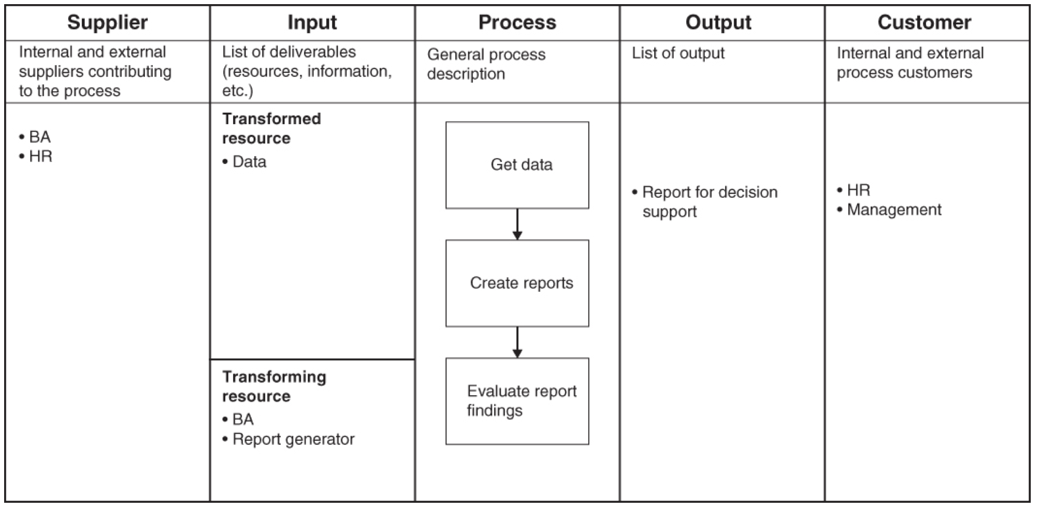

Slide 12
New process proposal
Use data mining to identify which employees leave the company, why, and when
Attempt to retain the employees with salary packages, education and training, or dialogue with management
Could also use insights when hiring new employees
Managing employees also incentivized to act on the new data

Slide 13
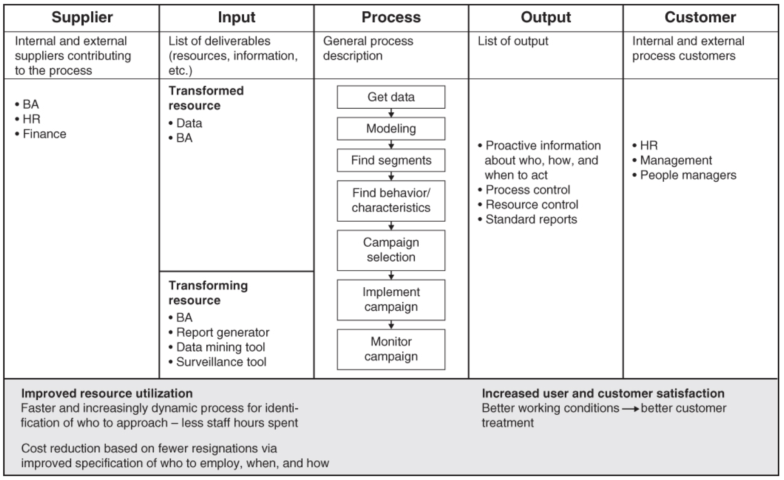

Slide 15


